Slide 1
Certified in Risk and Information Systems Control (CRISC)
Identifying and Managing Risk Scenarios

Slide 2
Risk Scenario Development
A risk scenario is a description of a possible threat event whose occurrence will have an uncertain impact on the achievement of the enterprise objectives, which may be positive or negative.
Risk scenarios are most often written as narratives, describing in detail the asset at risk, who or what can act against the asset, their intent or motivation (if applicable), the circumstances and threat actor methods associated with the threat event, the effect on the company if/when it happens, and when or how often
Risk scenarios bring value by representing risk in a tangible and assessable fashion.
Each scenario is based on a specific, unique individual risk. Each scenario documents the level of risk associated with a specific scenario in relation to the business objectives or operations that would be impacted if that risk event were to be realized.
The following question to be answer during the creation of Risk Scenario
      Who is the Threat Actor? Internal staff, 3rd party, competitor, etc.
      What is the Threat Type? Malicious, error, accident, etc.
      What is the Threat Event? Disclosure, interruption, theft, misuse, etc.
      Which Assets is at risk? People, process, systems, applications, network, etc.
      What Vulnerabilities are on that asset that can be exploited by the threat?
      What is the expected event Time? Occurrence, duration, frequency, etc.

Slide 3
often people get vulnerabilities or threats confused with risks. Risk is only valid when there is both vulnerability and threat are present for a particular asset. For example, “a php vulnerability on a web application” is not the risk, neither something like a “sensitive data breach”.
Instead, an example of a risk scenario can be: “Cyber criminals are able to use the php vulnerability on the external facing ecommerce web application to download large amount of personal credit card data, once in a year.”
Another risk Scenario is a Server which process customers payment is down due to cyber-attack for more than 1 day and make your organization unable provide the service of allowing customer payment
Risk scenario tell us story it could happen and allow you to collaborate with other and ask your self-questions like what we should do to get back on service and how to work around and how to be stay on service
You should update your risk Scenario all time with new assumptions and other new threat and Vulnerability
Risk analysis is a way of risk identification and will include some assumption and control to be implement

Slide 4
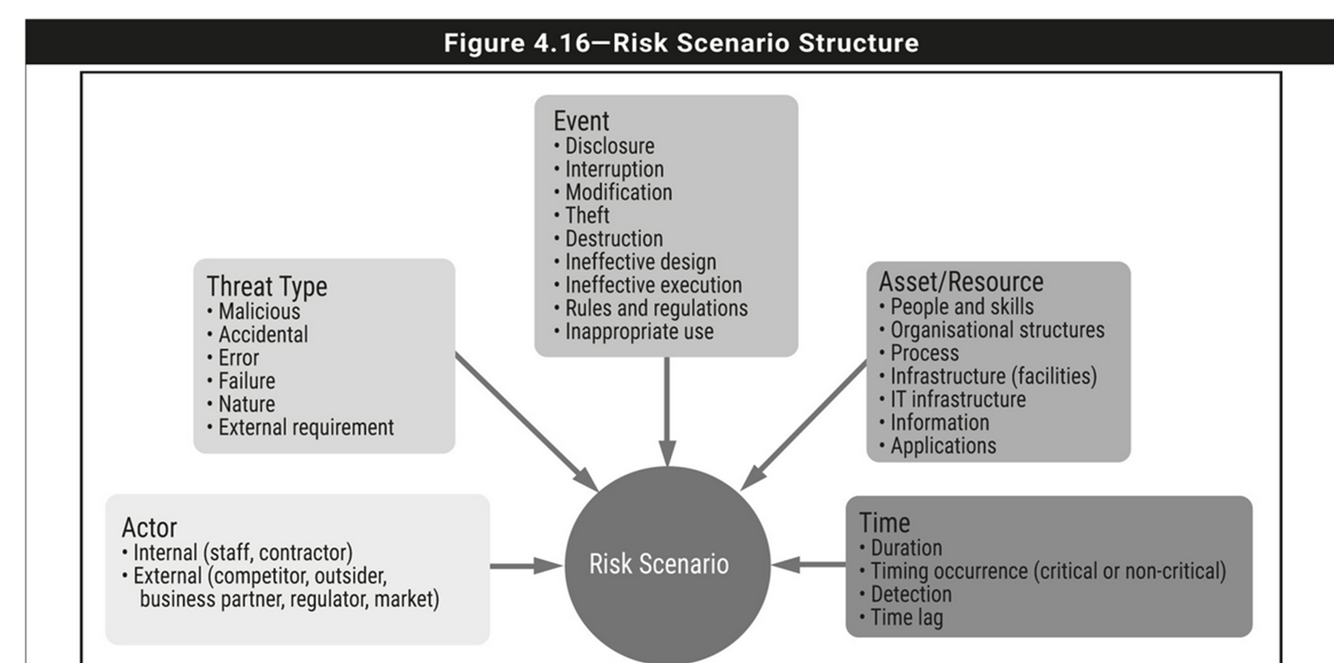
An IT risk scenario should include the following components:

Slide 5
Assets
Asset:
  Tangible: equipment or systems, people, facilities, process, methods
  Intangible: consumer confidence, customer loyalty, reputation
  Anything else the organization places a value on.
Intangible assets are more difficult to develop risk scenarios around.
When developing risk scenarios, assets should be identified as concretely as possible.
Identifying assets and prioritizing them based on their importance to the organization is sometimes referred to as a criticality analysis. It is an essential step in the process of developing risk scenarios.

Slide 6
Threats and Vulnerabilities
Threats are negative events; they are initiated by threat agents and exploit vulnerabilities inherent to an asset, a process, people, technology, or an organization.
Vulnerability: are weaknesses inherent to assets
Threats directly affect vulnerabilities, turning any “potential” for damage into real damage and impact if they are able to successfully exploit those vulnerabilities.
Risk scenario development directly depends on identifying all the potential vulnerabilities an asset may have.

Slide 7
Time and Location
The time and location defines the risk scenario event occurrence itself, turning it from risk into reality.
Time characteristic defining when the event occurs. It describes the duration of the event and how long it takes the organization to detect, respond to, analyze, and contain an event.
  Some risk scenarios occur at different times, such as during peak or even off-
hours, or occur during critical events, such as fiscal year, or during tax season.
Location geographical characteristic of the risk scenario event, it means whether a risk scenario occurs internally to a business or in its external environment.

Slide 8
Risk Scenario Development Tools and Techniques
  The development of risk scenarios is based on describing a potential risk event and documenting the factors and areas that may be affected by the risk event.
  Each scenario should be related to a business objective or impact.
  Risk events include system failure, loss of key personnel, theft, network outages, power failures, natural disasters or any other situation that could affect business operations and mission.
  The key to developing effective scenarios is to focus on real and relevant potential risk events.
  Examples of this would be to develop a risk scenario based on a radical change in the market for an organization's products, a change in government or leadership or a supply chain failure.
  Incidents that have occurred previously may be used as the basis of risk scenarios with far less effort put into their development.
  Risk scenarios can be developed from a top-down perspective driven by business goals or from a bottom-up perspective originating from hypothetical scenarios, as shown in figure 2.16.

Slide 9
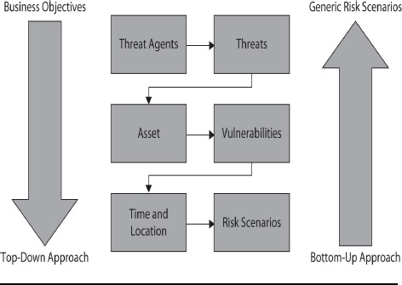
Developing Risk Scenarios Approaches
ISACA calls for a formal process for developing risk scenarios that takes one of two possible approaches:
  Top-Down Approach
  Bottom-Up Approach

Slide 10
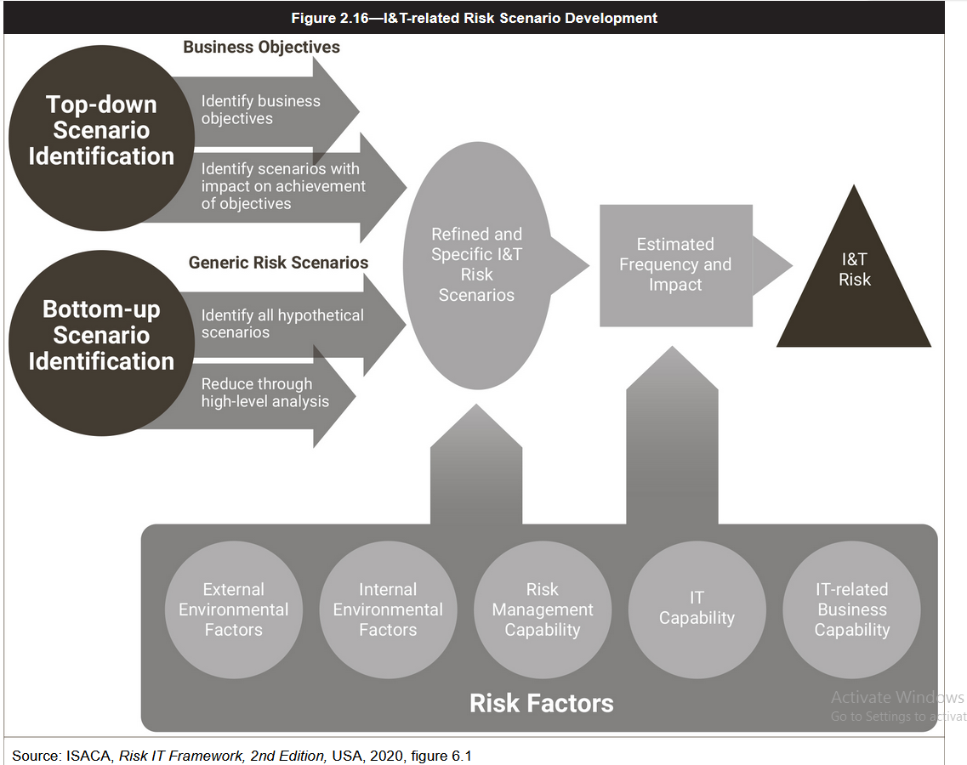

Slide 11
Top-down Approach
  A top-down approach to scenario development is based on understanding business goals and how a risk event could affect the achievement of those goals.
  Under this model, the risk practitioner looks for the outcome of events that may hamper business goals identified by senior management.
  Various scenarios are developed that allow the enterprise to examine the relationship between the risk event and the business goals, so that the impact of the risk event can be measured.
  By directly relating a risk scenario to the business, senior managers can be educated and involved in how to understand and measure risk.
  The top-down approach is suited to general risk management of the company, because it looks at both IT- and non-IT-related events.
  A benefit of this approach is that because it is more general, it is easier to achieve management buy-in even if management usually is not interested in IT.
  The top-down approach also deals with the goals that senior managers have already identified as important to them.
Disadvantage it is narrowly focused and may not consider all potential risk scenarios, especially remote or seemingly unrelated ones.

Slide 12
Bottom-up Approach
  The bottom-up approach to developing risk scenarios is based on describing risk events that are specific to individual enterprise situations, typically hypothetical situations envisioned by the people performing the job functions in specific processes.
  The risk practitioner and assessment team start with one or more generic risk scenarios, then refine them to meet their individual organizational needs including building complex scenarios to account for coinciding events.
  Bottom-up scenario development can be a good way to identify scenarios that are highly dependent on the specific technical workings of a process or system, which may not be apparent to anyone who is not intimately involved with that work but could have substantial consequences for the enterprise.
  Disadvantage
    the risk scenarios developed may be too numerous and may span all manner of likelihood, causing them to be unwieldy to manage and maintain
    it may take a lot of work to reduce the number of relevant, likely scenarios to a manageable level.

Slide 13
Benefits of Using Risk Scenarios
  Risk scenarios facilitate communication in risk management by constructing a narrative that can inspire people to act.
  The use of risk scenarios can enhance the risk management effort by helping the risk team to understand and explain risk to the business process owners and other stakeholders.
  Additionally, a well-developed scenario provides a realistic and practical view of risk that is more aligned with business objectives, historical events and emerging threats envisioned by the enterprise than would be found by consulting a broadly applicable standard or catalog of controls.
  These benefits make risk scenarios valuable as means of gathering and framing information used in subsequent steps in the risk-management process.

Slide 14
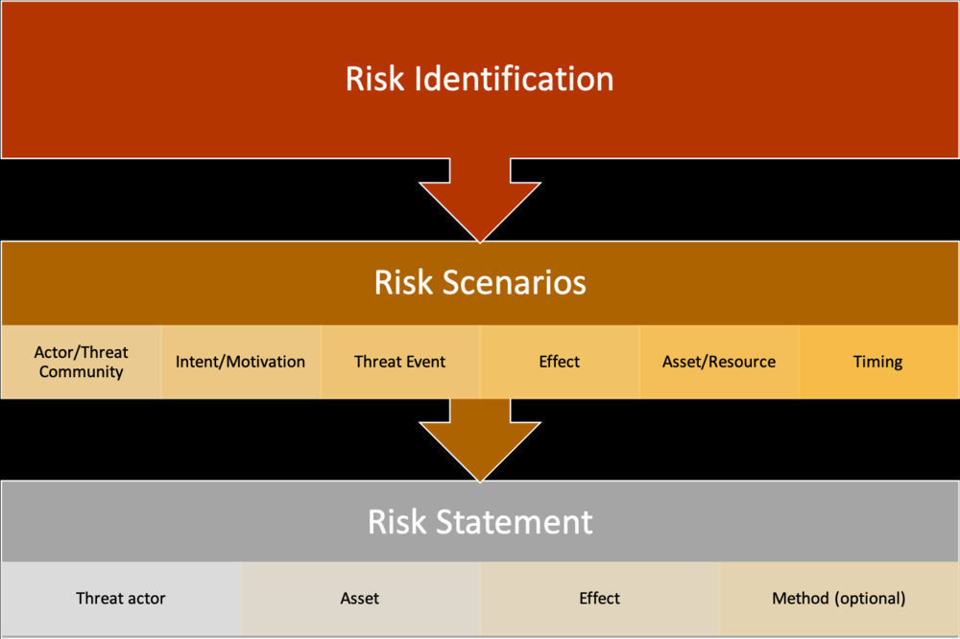
Risk scenarios and statements are written after risks are identified
Scenario building is a crucial step in the risk management process because it clearly communicates to decision-makers how, where, and why adverse events can occur.
Risk statements are description of risk that everyone from the C-suite to developers can read and get a clear idea of how an event can affect the organization if it were to occur.
Risk statement examples
Privileged insider shares confidential customer data with competitors, resulting in losses in competitive advantage.
Cybercriminals infect endpoints with ransomware encrypting files and locking workstations, resulting in disruption of operations.
Cybercriminals copy confidential customer data and threaten to make it public unless a ransom is paid, resulting in response costs, reputation damage and potential litigation.
Figure above for the components of a risk scenario.
Risk scenarios are most often written as narratives, describing in detail the asset at risk, who or what can act against the asset, their intent or motivation (if applicable), the circumstances and threat actor methods associated with the threat event, the effect on the company if/when it happens, and when or how often the event might occur.

Slide 15
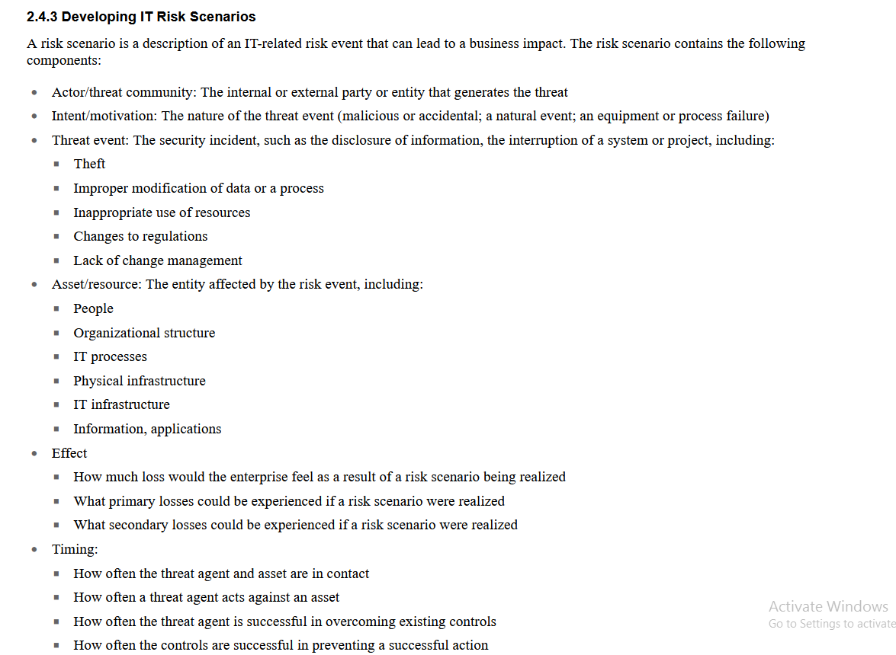

Slide 16
Example Risk Scenario
A foreign intelligence agency uses a zero-day exploit to cause a buffer overflow in a critical U.S. Department of Defense Internet-facing web application, resulting in the ability to execute arbitrary commands on the system and exfiltrate data.
The attack is not detected because of a lack of adequate intrusion detection security controls in place; therefore, the response and mitigation for the attack are delayed.
Because of potential delay in detection and response, the foreign agency could carry on the attack at any time they want, for as long as they want, until the threat is detected and defended against.

Slide 17
Example Risk Scenario: Answer
Risk Scenario Component | Description
Threat Agent | Foreign Intelligence Agency
Threat | Zero-Day Exploit
Asset | Critical System Application
Vulnerability | Application vulnerability allowing a buffer overflow
Time/Location | Time and duration of attacker’s choosing; external systems only; indefinite delay in detection and response time

Slide 18
Structure of risk scenarios
  Because [risk cause],
  [risk event] happens,
  causing [risk impact].
Example 1:
  Because a system does not enforce strong passwords or account lockout policies and does not log failed login attempts,
  a hacker gains unauthorized access to information stored in the system by performing a brute-force-password-guessing attack.
  The hacker uses the information to commit identity fraud that leads to an investigation by the Privacy Commissioner and reputational damage to the Minister and government organization.
Example 2:
  Because disk encryption has not been enabled on all of the organization's laptop devices,
  when an employee loses their laptop,
  this leads to official information being disclosed to an unauthorized party and reputational damage to the Minister and government organization.

Slide 19
Types of Cyber Risk Scenarios
Risk Scenarios Fall into Seven Categories
  1. Malware /Ransomware attack
    Malware-based attack designed to pressure a company to pay a ransom by encrypting and withholding access to systems or files, and furthering extorting the victim by threatening to make public sensitive information.
    An apparent ransomware attack may also be a cover for “wiper” malware intended purely for destruction of data and systems for example.
    Shamoon, also known as W32. Distrack, is an aggressive, disk-wiping malware program that was first seen in attacks on the Saudi energy sector in 2012 by a a company insider with privileged access to Aramco's network. The discovery of the malware was announced by Symantec and Kaspersky Labs in August of 2012
    Over 35.000 computers at Aramco became useless and had to be replaced. The virus erased data on three-quarters of Aramco’s corporate PCs, such as documents, spreadsheets, e-mails and other important files.
    Aramco was forced to shut down the company’s internal corporate network, disabling employees’ e-mail and Internet access, to stop the virus from spreading.
    The attack destroyed 85 percent of the company’s hardware and for ten days made business operations impossible.31 Another well-known example of a ransomware attack is WannaCry, a ransom crypto worm that affected more than 200,000 computers across more than 150 countries.

Slide 20
2. Insider Error
Misconfigurations, failure to renew expired certificates, improper publishing and other errors by staff members can have damaging consequences to the bottom line.
3. Insider Privilege Abuse
Whether it is the intentional and malicious disclosure or modification of sensitive data or a logic bomb taking down the network, your most trusted employees can cause significant loss to the company by sabotage.
4. System Intrusion
Through code exploitation or good old fashioned brute force password guessing, a bad actor gets a foothold in your network and can access your most sensitive assets, resulting in a data breach, business interruption or other perils. This category does not include ransomware or social engineering-based attacks.
5. Social Engineering
Tricking insiders into sharing confidential or personal information or making a payment, often through an email that appears to come from a friend, a well-known brand or business partner, possibly resulting in data breach or business interruption if an attacker gains entry to the network.
6. Web Application Attacks
Compromise of a web application via brute force or code exploitation to create business interruption or data breach, or possibly gain a foothold to target critical assets.
7. Denial of Service
Attackers flood the victim’s system with traffic, making it unavailable and leading to business interruption.

Slide 21
Developing Risk Scenarios
Review business and mission and determine what types of risk could impact the achievement of the mission.
Generate risk scenarios for all the possible negative events that could happen to the organization.
Develop more detailed risk scenarios that could affect particular business objectives or units.
Collect and assimilate data on the business’s operational environment.
Collect information on the possible threat agents, threat vectors (methods that a threat actor uses to deliver a threat), assets, and vulnerabilities.

Slide 22
IT Infrastructure Factors
IT infrastructure is both an internal and external risk factor.
  Internal pieces support organization’s processes
  External pieces support organization’s outside interactions
This increases the risk and the number of possible scenarios it may encounter.
Design and implementation of infrastructure can increase or decrease the likelihood or impact of the risk scenario.
  Outdated or overtaxed infrastructure introduces risk into the organization and exposes the organization to many more risk scenarios than a more modern, robust infrastructure.

Slide 23
Risk Scenario Stakeholders
Stakeholders include
  People who directly manage or are responsible for the asset or process in question, or who manage the affected organizational level.
  People responsible for managing risk associated with their asset or area
  People who are in management or executive positions responsible for managing risk throughout the entire organization.
For risk scenarios
  Develop a list of potential stakeholders
  Include them in your discussions concerning risk to their areas that might be affected.
  Send them all relevant products you produce regarding the risk that could potentially affect them, such as assessments, briefings, and reports.
They should be considered before and after developing risk scenarios to develop a more detailed scenario, based on their knowledge of relevant factors.

Slide 24
Analyzing Risk Scenarios
Analyzing risk scenarios to calculate their impact and likelihood
Factors that may affect the calculation.
  organizational factors, such as structure, policies, and
  infrastructure factors, such as technology, architecture, and security controls.
These different factors weigh in on how likely a risk scenario is to take place, as well as what its potential impact will be to the asset or organization.

Slide 25
Likelihood and Impact
Likelihood is the realistic level of certainty that an event will occur, i.e. how likely a threat is to exploit a particular vulnerability.
  The terms likelihood and probability are similar, determining the probability of an event implies the use of statistical analysis, definitive quantifiable data, and mathematics.
Impact is the degree of harm to an asset or the organization.
  Sometimes impact is measured in terms of cost, such as dollars to replace an asset.
  Impact may not necessarily be a single instance of loss.

Slide 26
Organizational Factors Affecting Likelihood and Impact
Organizational structure:
  Chain of command, span of control, budget and resource allocation, and business priority.
  Processes since the organization may be organized on a functional basis.
  The way the organization prepares for and responds to risk scenarios.
Organizational governance:
  Drive the organizational direction in terms of compliance.
  May help or hinder the business’s risk strategy, depending upon the importance that
organizational leadership places on risk management.
Organization’s tolerance and appetite for risk:
  Organization may engage in riskier business pursuits, which may increase risk scenarios and their likelihood and impact.
  Organizations that have a low tolerance and appetite for risk reducing the number and
level of risk scenarios that may affect them and reducing likelihood and impact.
  Organizations that tend to have a lower risk tolerance and appetite may also increase their level of commitment to controls that would reduce risk.

Slide 27
Technological Factors Affecting Likelihood and Impact
Organizations that rapidly change business strategy or markets or develop new products or processes are typically at the mercy of established infrastructures that are more slow-moving or even static in nature.
  the static nature of installed technology may actually increase the likelihood and impact of risk scenarios.
  New and emerging threats that are identified every day also cause an
organization’s technologies to be in reactive mode.
Technology can have both positive and negative effects on likelihood and impact.

Slide 28
Risk Register
Risk register
is a product or document that reflects the different risk scenarios and factors for a given context.
It could be for a single system, for a component of the system, or even for a higher-level organizational element.
It also may address only a small portion of the specific piece of risk.
The risk register is used to record and manage risk and serves as a reference point for tracking risk through its life cycle.
Different organizations may have different entries or elements on their own risk registers.

Slide 29
Elements of Risk Register
Risk register could include the following:
  Risk factors
  Threat agents, threats, and vulnerabilities
  Risk scenarios
  Criticality, severity, or priority of risk
  Asset information
  Impact of the risk on an asset
  Likelihood of the threat exploiting the vulnerability
  Current status of risk response actions
  Resources that may be committed to respond to risk
  Risk ownership information
  Planned milestones toward risk response

Slide 30
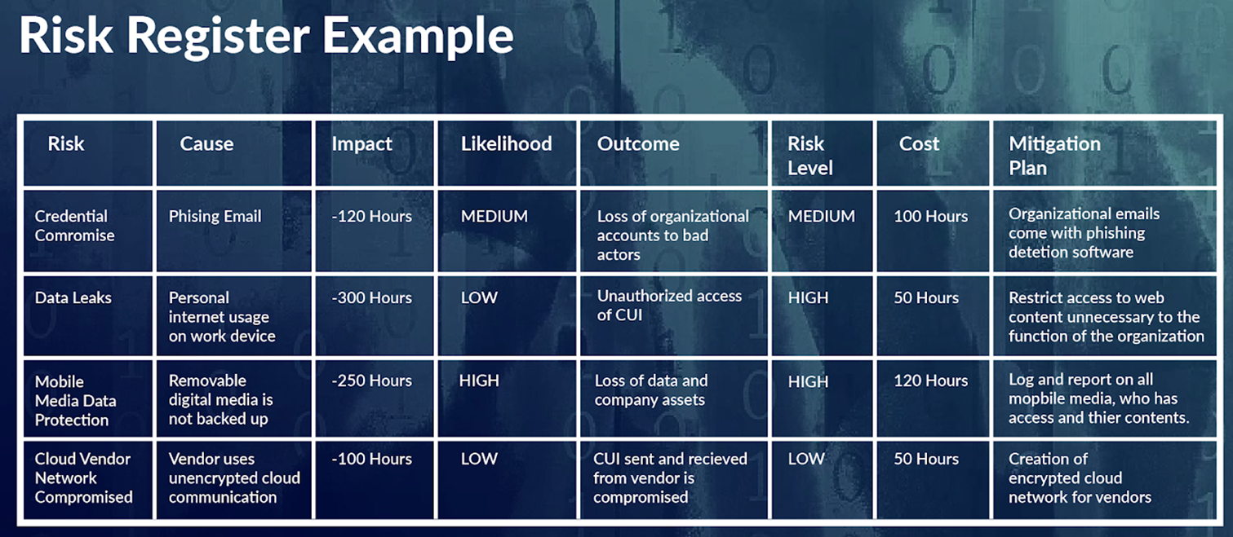
Basic Risk Register Example

Slide 31
Creating and Maintaining a Risk Register
Creating and maintaining risk register is usually determined as part of the organization’s risk management strategy and plan.
Determine all the different risk factors that affect a given asset or organizational element.
Develop risk scenarios within the context of the specified asset or process and map them to those assets on the register document.
Consider all threats, vulnerabilities, likelihood, and,
Quantify (or qualify) risk according to the assessment methodology used, and record it in the risk register.

Slide 32
Thank you

